Slide 1
Structure Learning Using Forced Pruning
Pracheta Sahoo, Chiradeep Roy, Ahmed Abdelatty

Slide 2
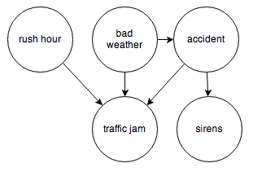
Structure Learning
It is simply the task of learning the structure of the network from data.
r | b | t | a | s
y | y | n | y | y
y | n | y | y | y
n | n | n | n | n
y | y | y | y | y
y | n | n | n | y
n | y | n | n | n

Slide 3
Structure Learning (contd.)
There are many approaches for learning Markov Networks structures:
Solving global search problem.
Learning a set of local models and then combining them into a global model.

Slide 4
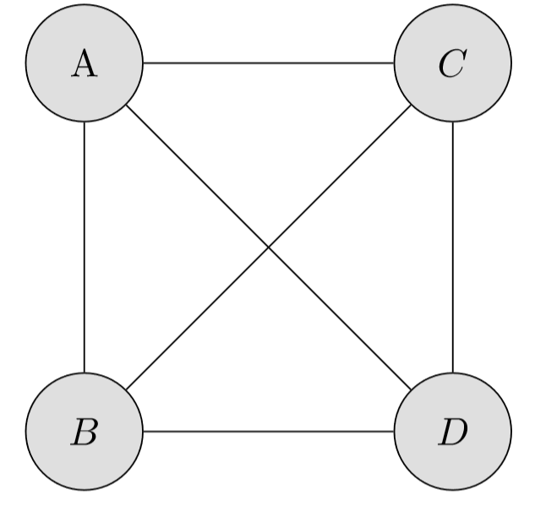
Challenges
As we know fully connected networks are the best structure we can learn.
However, the model will overfit the training data and we will need a huge storage space.

Slide 5
Challenges (contd.)
Structure learning is generally a very hard problem. Some of the reasons for this are:
Finding the best possible I-Map We need to find a network H that incorporates as many of the original independencies of the original distribution P
Data Fragmentation The number of samples needed to learn the data might be very large when the true model has nodes with a large number of dependencies

Slide 6
Types of Approaches
Generally, there are two kinds of approaches that can be used in theory:
Constraint-based approaches Search for a graph H that is a perfect map of P and encodes all its independencies.
Score-based approaches Define objective function to score models and prefer higher scoring models to lower scoring ones.
In this presentation, we will focus on score-based approaches of learning Markov Networks greedily from fully observable data.

Slide 7
Greedy Structure Learning
The basic premise of this kind of structure learning is
Start out with a basic model
Do parameter estimation for the current model
Do greedy local search by slightly changing the current model by applying a series of operators
Keep repeating steps 2. and 3. until termination condition is met

Slide 8
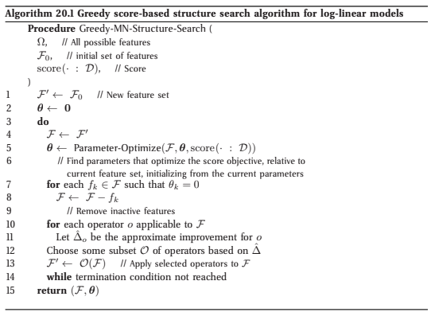
Greedy Structure Learning (contd.)
Taken from pg. 986 Probabilistic Graphical Models (Principles and Techniques) by Daphne Koller and Nir Friedman

Slide 9
State-of-the-art Solution
Some state-of-the-art algorithms uses L1-Regularization to force many of the parameters to be zero.
We can then delete edges with associated parameters equal to zero.
However, they have no criteria to define the number of pruned edges.

Slide 10
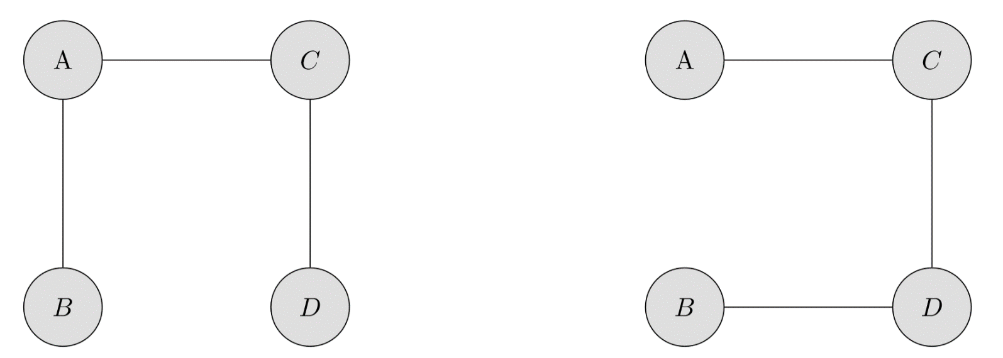
Our Approach
Define a fixed number of edges M and select the best model that has only M edges
The number of such models is

Slide 11
Our Approach (contd.)
We use an algorithm that is similar to the greedy template
shown in the last slide:
Start with a complete graph
Generate a Chow-Liu Tree
Add m (=M-N+1) edges to the given tree and use parameter estimation
Keep removing and adding K edges such that the delta-gain keeps increasing

Slide 12
Our Approach (contd.)
Parameter-Learning Step We are maximizing over the pseudo-log likelihood (PLL) of the data with Automatic Parameter Tying (more on this later) instead of L2 regularization.
Structure-Selection Step We are choosing the K edges that result in the maximal increase of the PLL score. We are using APT in this step as well.

Slide 13
Automatic Parameter Tying
Achieve compression
Ability to express the data using very few parameters or clusters
Maximization of likelihood
Regularization is used as a penalty term if the weight deviates from what it has to be then it gives a penalized score to the model
We use regularization penalty to overcome overfitting in MLE and MPLE models
MLE is a concave function, so gradient ascent can optimize it but computing log partition function is intractable. So we use PLL.

Slide 14
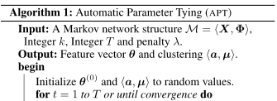
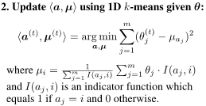

APT Algorithm (Slide Courtesy Li Chou)
Block coordinate ascent
Notes:
Since the reformulated learning objective is not convex, we propose the following block coordinate ascent based algorithm
The algorithm alternates between:
1. maximize the likelihood given clustering assignments
2. find optimal clustering given updated (learned) parameter values
Remarks on APT algorithm
Returns soft clustering; but can also handle hard clustering
Objective function is bounded above; guaranteed to converge to local maxima
Requires inference; use (mini-batch) gradient ascent and pseudo likelihood

Slide 15
Structure Learning of Markov Network
This project is very interesting because we first learn the structure of a Markov net and then we estimate the parameters (incremental feature selection)
The objective function needs to be maximized and there are some heuristics which are taken into account to choose the edges/ features which can maximize the likelihood objective
We also cluster our parameters in order to learn a structure. This is also a form of constrained learning.

Slide 16
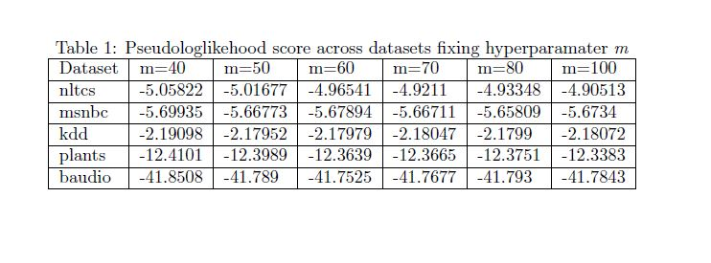
Results

Slide 17
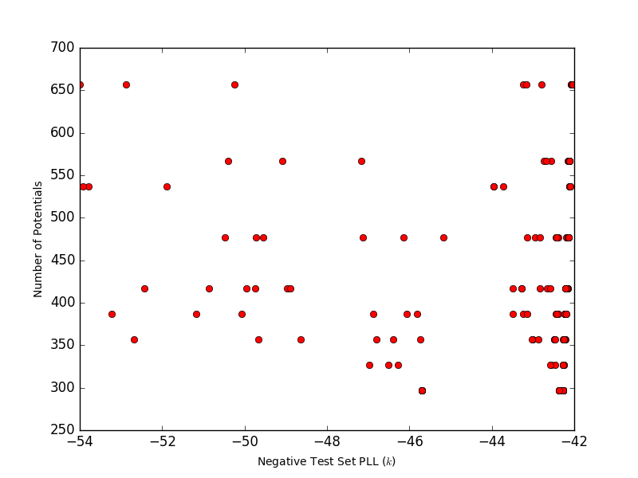
Baudio (cluster=5)

Slide 18
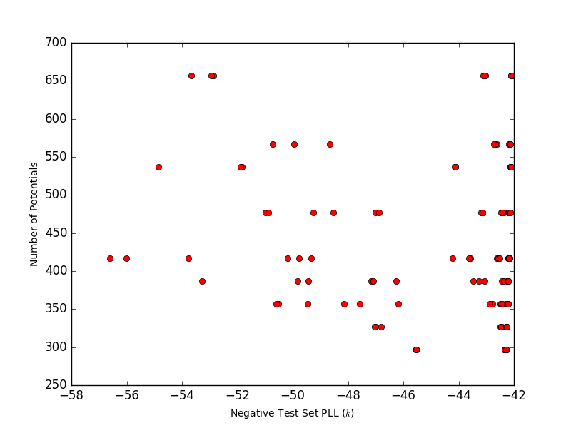
Budio (cluster=10)

Slide 19
Baudio (cluster=25)

Slide 20
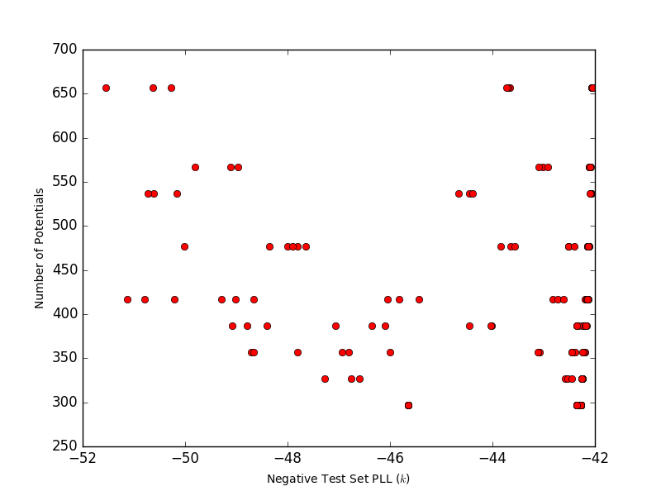
Baudio (cluster=50)

Slide 21
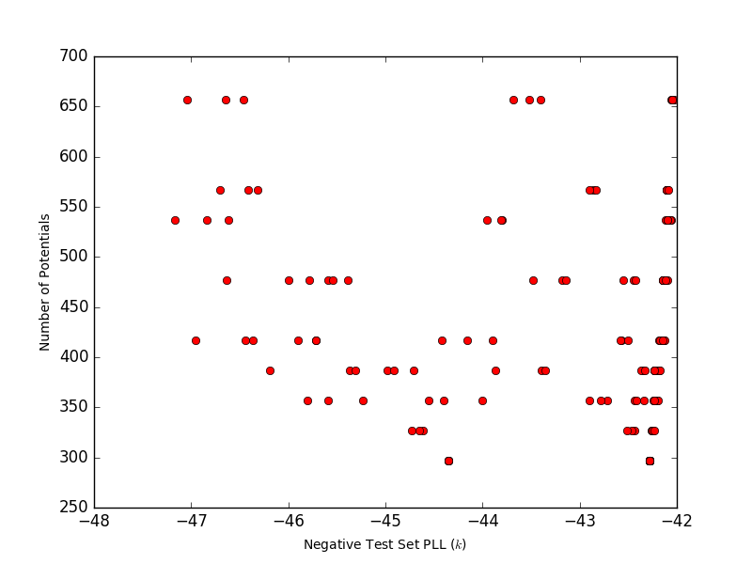
Baudio (cluster=100)

Slide 22
Future Work
We will investigate better ways to prune the edges instead of using m and k hyperparameters.
We can perform the experiments in featurespace instead of edgespace.

Slide 23
Thank you!!!!!

